Slide 1
Utilizing Embryonic Stem Cell Research to Cure Alzheimers Disease
By: Mckenzie Gatz

Slide 2
What are Stem Cells…
Stem cells are capable of dividing and renewing themselves.
Stem cells are unspecialized.
Stem cells can become specialized cells that have the potential to replace damaged cells.
http://www.youtube.com/watch?v=HZWVj5mqJ1I&feature=player_detailpage

Slide 3
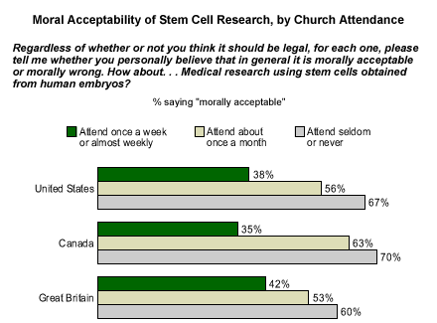
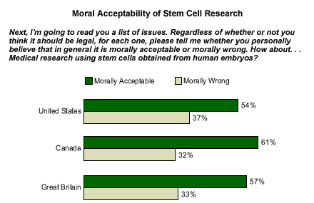
Embryonic vs. Adult stem cells
Embryonic stem cells have no limitations and are the only stem cells that have demonstrated the potential to specialize into any cell in the body.
Adult stem cells are limited to differentiating into the cell types of their tissue of origin.

Slide 4
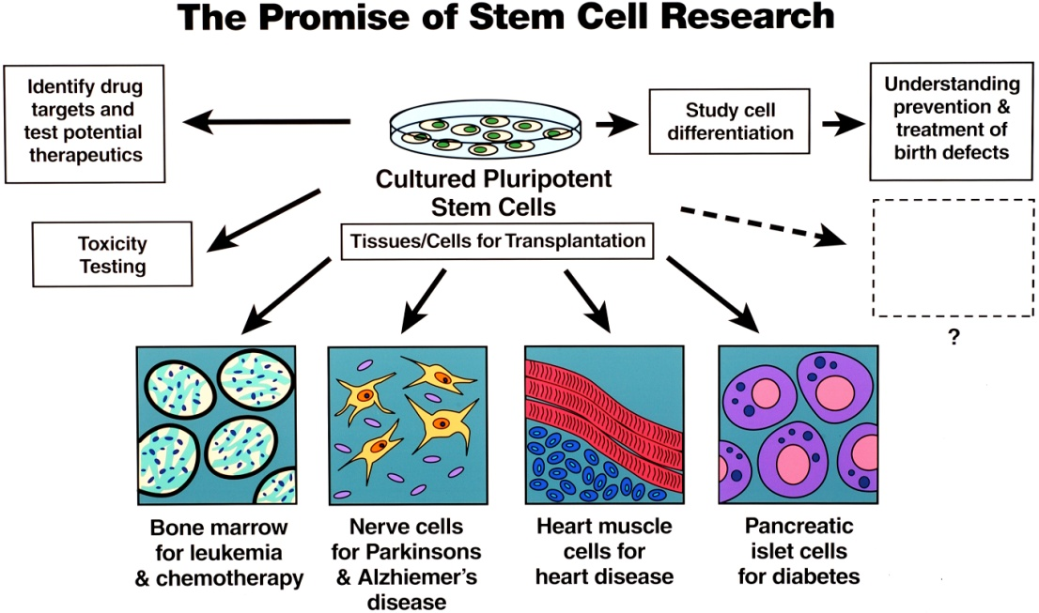
Potential uses of stem cells
Replace Damaged Tissues-Stem cells, directed to differentiate into specific cell types, offer the possibility of a renewable source of replacement cells and tissues to treat diseases including Parkinson's and Alzheimer's diseases, spinal cord injury, stroke, burns, heart disease, diabetes, osteoarthritis, and rheumatoid arthritis.
Studying Human Development-Studying embryonic stem cells may help scientists better understand how cancer and birth defects develop, both of which are due to abnormal cell differentiation and/or division
Testing New Drugs-Human stem cells could be used to test new drugs. Some drugs are already tested on cells generated from human cell lines, but advancements would allow a wider range of drugs to be tested.

Slide 5
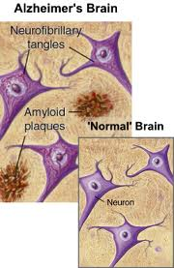
Curing Alzheimers Disease
Stem cell research does offer hope for a number of diseases including Alzheimer's. Treatment success will depend on a number of factors, among them:
-The ability to understand more about normal cell development
-The ability to correct errors and damage to diseased and abnormal cells
-The ability to understand the process by which stem cells transform into other cell types
-The ability to make sure any stem cell treatments are safe

Slide 6
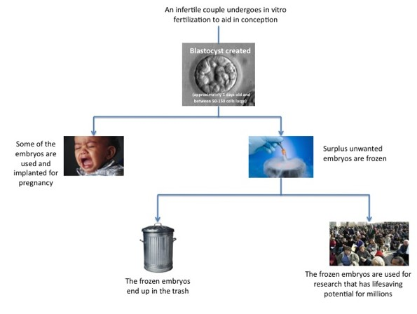
Moral and Ethical Dilemma
Stem cell research, and the fear of the unknown, has sparked controversy and debate over its morality. With accurate information and straightforward facts, most people find stem cell research within their moral and ethical boundaries.

Slide 7
Where our government stands
http://www.youtube.com/watch?feature=player_detailpage&v=TRtlkcQ6brE
1996 Congress passed the Dickey-Wicker Amendment-
August 9, 2001, President Bush
March 9, 2009, President Obama
August 2010, Chief Judge Royce C. Lamberth of Federal District Court
http://www.youtube.com/watch?v=whMnHjVzg4s&feature=player_detailpage

